Slide 1
Information Literacy
Madison Miller

Slide 2
What is information literacy?
The ability to identify needed information
The knowledge to know where to find the information
Being able to break down the information to retain knowledge
Having the ability to communicate your newfound knowledge
Source: http://www.wesleyan.edu/libr/infoforyou/infolitdefined.html

Slide 3
Why is information literacy important?
There is a lot of information out there! It is important to be able to know the good from the bad.
In order to find what you are looking for, it is important that you can break down your search effectively to get the best results online.
The amount of information is only continuing to grow!

Slide 4
Domain names
URL: the address of a world wide web page, usually located at the top of your internet browser.
Tells you what kind of source you are looking at.
There are several different types:
.edu- short for educational. The information is put out by universities and is not sponsored. They are reserved exclusively for accredited degree granting institutions. This is usually a reliable source of information.
.gov- short for government. This is a sponsored source, which derives the information it puts out from government entities in the United States. This is also a great place to start to find information, not much to filter through.
.org- short for organization. Reserved for non-commercial (or non profit) organizations mostly in the U.S. and Canada. This is a good source, but can be biased towards the interests of the organization, so be mindful of that.

Slide 5
Domain Name continued…
.net- stands for network. It was originally meant for organizations involved in networking technologies, such as Internet service providers and other infrastructure companies.
.com- stands for commercial. Intends to show the information that is currently being published. You can find good information here, but it may take some more effort to find quality, factual information.

Slide 6
Good Websites:
Easy to navigate
Don’t have a lot of advertisements. Some is okay
Loads quickly
Free from factual and grammatical errors
Look presentable, easy to read
Clearly state the authors name
Cite their sources
Has up to date information

Slide 7
Bad Websites
Confusing, hard to work your way around
Have a lot of advertisements
Take a long time to load
Have incorrect information and grammatical errors
Biased information
No author
No citations
Outdated information

Slide 8
What is a search engine?
A program that searches for and identifies items in database that correspond to key words and letters specified by YOU.
There are a lot more search engines than Google! I will show you some of them on the following slides.

Slide 9
What is E-Learning?
E-Learning is usually something that happens online through a variety of different resources.
There are a lot of websites that can help you learn online!
Why is E-Learning important?
We live in a technologically advanced world that continues to grow.
It reaches a large amount of different learners.

Slide 10
Search Engine #1
Dogpile
www.dogpile.com
Powered by Metasearch technology and returns the best results from the leading search engines including Google and Yahoo.
Arfie is the mascot and he was born 1/2/96
Dogpile was created in November 1995

Slide 11
URL
Enter your search here

Slide 12
I searched for turtles
These are Ads…scroll down for the best links

Slide 13
Search from here…for images and video go back to the top left corner

Slide 14
Select Images
Start looking here

Slide 15
Click here
Here is how you change your search filter for different results

Slide 16
Find searching tips and tricks by following the URL above which is located on the ABOUT page for Dogpile

Slide 17
Search Engine #2
DuckDuckGo
https://duckduckgo.com/
They don’t store any personal information. Ever.
They do not track your searches, so they don’t follow you around with ads.
It does not matter if you are in private browsing mode or not, they don’t have any of your information.

Slide 18
URL
Enter your search here

Slide 19
I searched for turtles
Skip over this

Slide 20
Ad, don’t use this
This is a good place to start

Slide 21
Click Images
Large images are usually better quality

Slide 22
Click here for more recent information in your search

Slide 23
Click here for videos

Slide 24
Search Engine #3
Web Crawler
www.webcrawler.com
Web Crawler brings users the top search results from Google, Yahoo! and other popular search engines.
WebCrawler provides multimedia results, including images, video, news, and local information.

Slide 25
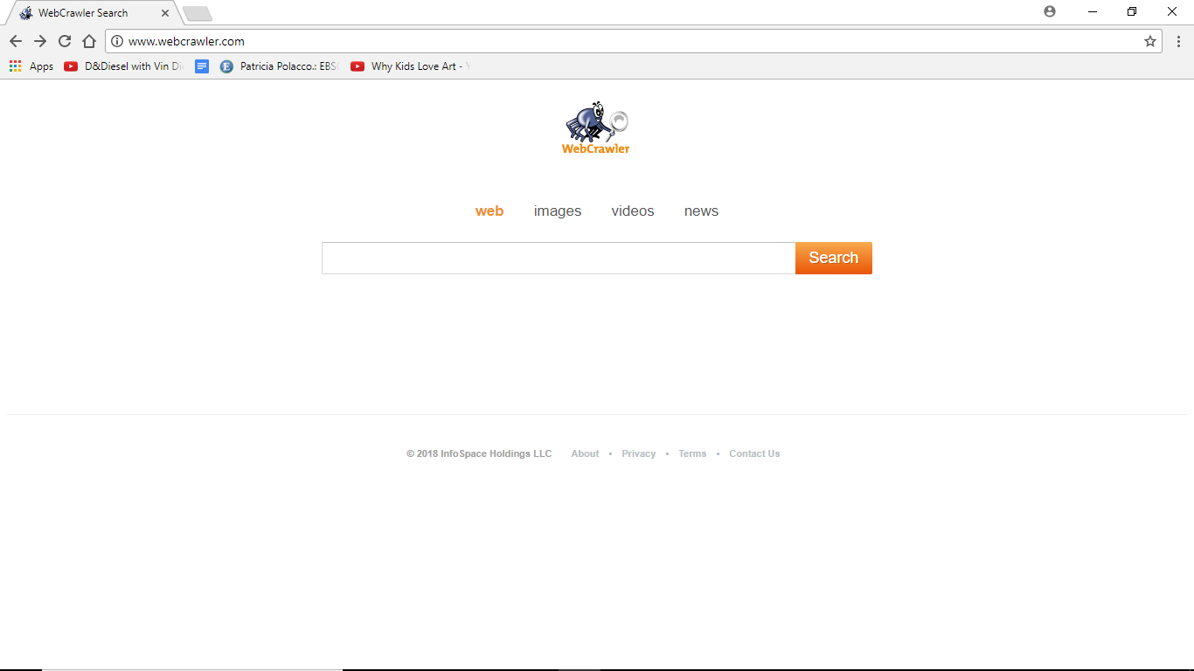
URL
Enter your search here

Slide 26
I searched for turtles
These are Ads. Scroll down

Slide 27
Start here

Slide 28
Click here for images
You can click on the right for more specific searches

Slide 29
E-Learning Cite #1
ArtforKidsHub
www.artforkidshub.com
A family of five are behind the screen of this website!
They make relevant art lessons, videos, projects for kids.
It is free to use, unless you don’t want any ads.
The father Rob Hubs, created the website so he could share his art experiences with his kids with other families.

Slide 30
URL
Ad. Don’t click here

Slide 31
Different Project types!
You can do A LOT without having the membership

Slide 32
S
C
R
O
L
L
D
O
W
N

Slide 33
Click the pictures to go to the lesson you want!

Slide 34
I clicked how to draw Black Panther
What you are going to need

Slide 35
Watch me!

Slide 36
E-Learning cite #2
Color with Leo
http://www.colorwithleo.com/artstudio.php
Teaching the principals of art to students
Founded by Norman E. Silva to create a wholesome learning environment online

Slide 37
URL
Games are free. Click the pictures to play!
LEO

Slide 38
Fill up the space!
Use the shapes to make a landscape!

Slide 39
More activities
You can print your finished project!

Slide 40
Ready for the quiz?
I AM NOT READY FOR A QUIZ
I’m ready, I’m ready,
I’m READYYY!

Slide 41
Question 1
What is the name if the mascot for the search engine Dogpile?
Alfred
Arfie
Fido
Snoop Dog

Slide 42
Question 2
What is a part of information literacy?
No knowledge
All knowledge
Ability to identify needed information
No newfound knowledge from research

Slide 43
Question 3
Which of the following is an example of a domain name?
.edu
.bla
.orj
.abc

Slide 44
Question 4
Which of the following makes a BAD website?
No citations
Easy navigation
Clearly states authors name
Easy to read

Slide 45
Question 5
What IS a part of E-Learning?
Exaggerated learning
Online learning
Worksheets
Example learning

Slide 46
Question 6
Where is the URL located?
At the bottom
In the middle
At the top
None of the above

Slide 47
Question 7
What should you avoid clicking on websites?
Ads
Images
Articles
Videos

Slide 48
Question 8
Who developed ArtforKidsHub?
Allen Hubs
Rob Hubs
Jay Johnson
Ray Miller

Slide 49
Question 9
Who is the mascot of our second E-Learning cite?
Leo
Jay
Bob
Jeffrey

Slide 50
Question 10
What does colorwithleo.com aim to do?
Help you with math
Teach you the principles of art
Draw trees
Help you with science

Slide 51
Congratulations!
Return to tutorial
Try again!

Slide 52
Help slide 1
Go back

Slide 53
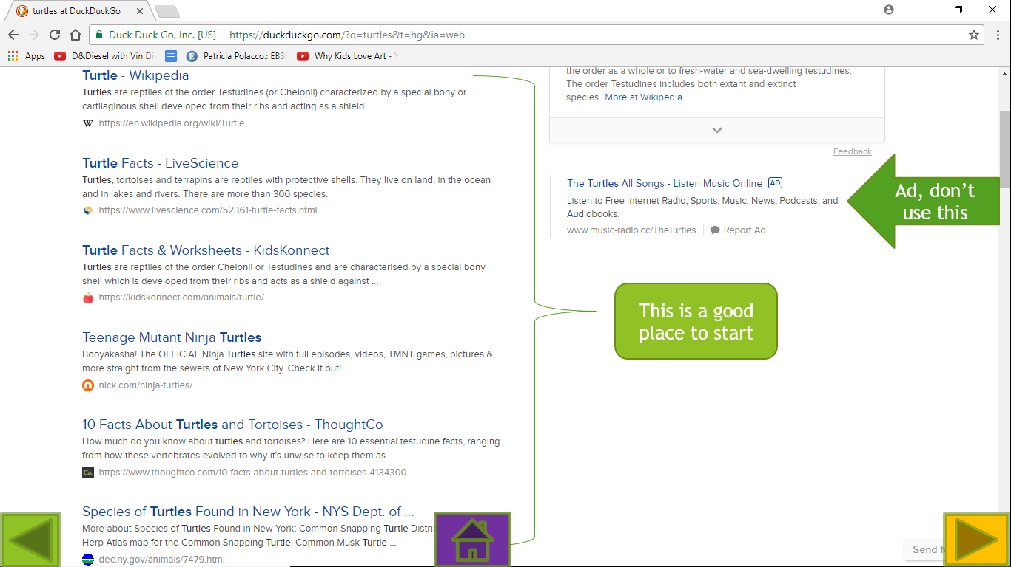
Help slide 2
Go Back

Slide 54
WRONG ANSWER
Try again

